Slide 1
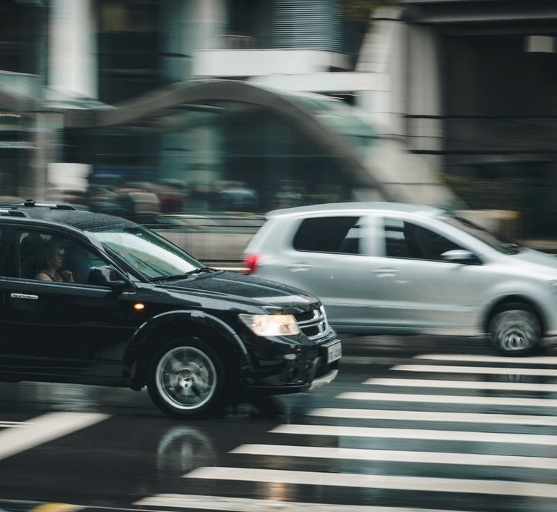
AUTOMATIC LICENSE NUMBER PLATE RECOGNITION SYSTEM
GANGA KRISHNAN.G
20MCA418

Slide 2



CONTENTS
Introduction
Related Works
Problem Statement
Objectives
Methodology
Conclusion
Future Enhancement
References

Slide 3

INTRODUCTION

Slide 4
A Number Plate is a metal or plastic plate attached to a vehicle for official identification purposes.
The License Plates are placed on the front and back of the vehicle.
Automatic License Plate Recognition (ALPR) or ANPR is the technology responsible for reading the License plates of a vehicle in an image or a video sequence using optical character recognition.

Slide 5
From the captured image or footage, ALPR detects and extracts your license plate number.
The project uses YOLOv4 object detector, OpenCV, and Tesseract OCR for ANPR.
The different terminologies used for ANPR systems include Number plate Recognition (NPR), Automatic License Plate Recognition (ALPR), License Plate Recognition (LPR), Automatic Vehicle Identification (AVI), Car Plate Recognition (CPR) etc.

Slide 6
RELATED WORKS

Slide 7
SL.NO | TITLE | YEAR OF PUBLISHING | PROS | CONS
1 | Chou, J.S.; Liu, C.H. Automated Sensing System for Real-Time Recognition of Trucks in River Dredging Areas Using Computer Vision and Convolutional Deep Learning. | 2021 | Real time detection | Format dependent
2 | Croce, A.I.; Musolino, G.; Rindone, C.; Vitetta, A Route and Path Choices of Freight Vehicles: A Case Study with Floating Car Data. Sustainability. | 2020 | Real time detection | Higher processing time, cost and power for higher resolution images

Slide 8
SL.NO | TITLE | YEAR OF PUBLISHING | PROS | CONS
3 | Singh, V.; Srivastava, A.; Kumar, S.; Ghosh, R. A Structural Feature Based Automatic Vehicle Classification System at Toll Plaza. | 2019 | Real time detection, Region of Interest (ROI) based filtering, Vertical Edge Detection with removal of long edges | Format dependent
4 | Sasi, A.; Sharma, S.; Cheeran, A.N. Automatic car number plate recognition. | 2018 | Support Vector Machine (SVM) with Preprocessing techniques is used for extraction. | Not Real time

Slide 9
SL.NO | TITLE | YEAR OF PUBLISHING | PROS | CONS
5 | Jia, Y.; Gonnot, T.; Saniie, J. Design flow of vehicle license plate reader based on RGB color extractor. | 2018 | Real time detection | Format specific. Not compatible with low light images. Ambiguous characters have low recognition

Slide 10
PROBLEM STATEMENT

Slide 11
The process of traffic control, vehicle identification and vehicle location tracking are done manually.
It accelerates time, cost and effort.
To overcome this problem , ANPR technology were introduced.ANPR technology makes the transportation system more intelligent.

Slide 12
OBJECTIVES

Slide 13
Improves road safety.
Reduces crime.
Gives officers better information to work with.
Deterring terrorism.
Pre-paid parking members can be easily differentiated from non-members.

Slide 14
METHODOLOGY

Slide 15
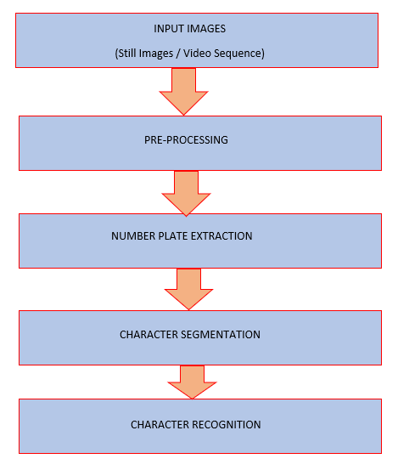

Slide 16
The input to this system is still image or video sequence.
The project uses YOLOv4 object detector, OpenCV, and Tesseract OCR for ANPR.
Object detector is to identify and crop License Plate region.
Then preprocess the identified region using OpenCV, an open-source library used to perform image processing and computer vision tasks.The dataset is preprocessed inorder to check missing values, noisy data, and other inconsistencies before executing it to the algorithm.

Slide 17
Character segmentation is to simplify or change the representation of an image into something that is more meaningful and easier to analyze.
Then, execute it through the Tesseract OCR to output the license Plate Number.
The backbone of this project is Tensorflow and is written in Python.

Slide 18
CONCLUSION

Slide 19
There is an immediate need of such kind of Automatic Number Plate Recognition System in India as there are problems of traffic, Stealing cars etc.
Government should take some interest in developing these kind of systems as this system is very economical and eco-friendly, if applied effectively.
This change will help in the progress of the nation.
Some of the applications of ANPR include Traffic control, Access-control, Tolling, Stolen cars etc.

Slide 20
FUTURE ENHANCEMENT

Slide 21
It is important to mention RFID technology here as future technology .
The integration of RFID and ANPR may result in a hybrid system and it can be considered for multiple applications of intelligent transport systems in present and future.
The hybrid solution making the transportation system more accurate and secure.

Slide 22
REFERENCES

Slide 23
Lubna, Naveed Mufti, and Syed Afaq Ali Shah –” Automatic Number Plate Recognition:A Detailed Survey of Relevant Algorithms “-Peshawar 25000, Pakistan; Lubnaxafi@gmail.com 2 Department of Telecommunication Engineering, University of Engineering and Technology, Mardan 23200, Pakistan 3 Department of Information Technology, Media and Communications, Murdoch University, Murdoch 6150, Australia; Afaq.Shah@murdoch.edu.au * Correspondence: Naveed@uetmardan.edu.pk-26 April 2021.

Slide 24
CHRIS HENRY , SUNG YOON AHN , AND SANG-WOONG LEE – “Multinational License Plate Recognition Using Generalized Character Sequence Detection”- Pattern Recognition and Machine Learning Laboratory, Gachon University, Seongnam 13557, South Korea, February 28, 2020.
Samiul Azam a,b,⇑ , Md Monirul Islam- ”Automatic license plate detection in hazardous condition” -Department of Computer Science, University of Calgary, Calgary, Alberta, Canada bDepartment of Computer Science and Engineering, Bangladesh University of Engineering and Technology, Dhaka, Bangladesh-6 February 2018

Slide 25
THANK YOU !!!

